Slide 1
ITG PROFILE

Slide 2
CONTENTS
1. Introduction About ITG
2. Typical Customer List
3. Typical Project List
4. Base Technology Of 3S Systems

Slide 3
ITG INTRODUCTION

Slide 4
INTRODUCTION ABOUT ITG TECHNOLOGY
15+
Years of Experience
ERP | MES | IIoT & Automation | BI | AI
+ Leading Developer & Provider in MES & Smart Factory Solution in Vietnam
+ TOP 50 Leading ICT Providers | 2017 | 2018 | 2019
+ Sao Khue Awards | 2008 | 2010
+ Strategic Partner of Qunie Corporation & Keyence Vietnam Technology in Smart Factory Solution
150+
High qualified Employees
Hanoi | Ho Chi Minh
1.000+
Customers
Manufacturing | Wholesales | Retails
5 Industries of Special Experiences
Electronics & Accessories | Machinery & Mechanicals | Furnitures | Printing & Packaging | Pharmacuticals
www.itgvietnam.com

Slide 5
INTRODUCTION ABOUT ITG TECHNOLOGY
VISION
SMART FACTORY,
INTELLIGENCE BUSINESS
CORE VALUES
HUMAN – TECHNOLOGY – MANAGEMENT KNOWLEDGE
Big Vision
Success Commitment
Free Creative
Progressive
Value Sharing
CULTURE GENES
ITG CULTURE
ITG CULTURE BASE
www.itgvietnam.com

Slide 6
TYPICAL CUSTOMER LIST

Slide 7
TYPICAL CUSTOMER LIST
www.itgvietnam.com

Slide 8
MECHINERY AND MECHANICAL
No | Customer | LOGO | Address
1 | GOSHI AUTO PARTS Co., Ltd |  | Factory 01: 134 Sai Dong Street, Long Bien, Ha Noi Factory 02: 134 Sai Dong Street, Long Bien, Ha Noi
2 | MATSUO Industry VN Co., Ltd |  | Factory 01: Lot C-10 Thang Long IZ, Dong Anh, Ha Noi Factory 02: Lot B -2 Thang Long IZ, Dong Anh, Ha Noi
3 | HANOI Electronic and Mechanical JSC |  | Km 12, Cau Dien Street, Bac Tu Liem, Ha Noi
4 | Yangmin Enterprise Co., Ltd |  | Dong Tho IZ, Yen Phong, Bac Ninh
5 | EBA Machinery VN Co., Ltd |  | Lot N1,2,3, Nomura IZ, An Duong, Hai Phong
www.itgvietnam.com

Slide 9
ELECTRONICS AND ACCESSORIES
No | Customer | LOGO | Address
6 | Rhythm Precision Vietnam Co., ltd - RPV |  | Factory 01: Lot 42 Noi Bai IZ, Soc Son, Ha Noi Factory 02: Lot 87 Noi Bai IZ, Soc Son, Ha Noi
7 | Meiko Electronics Thang Long Co., Ltd |  | Lot J1-J2, Thang Long I IZ, Dong Anh, Ha Noi
8 | HTMP Co., Ltd |  | Lot D3, Quang Minh IZ, Me Linh, Ha Noi
9 | FUKOKU Industry Co., Ltd |  | Lot H1, Thăng Long II IZ, My Hao, Hung Yen
10 | Sunlin Electronics Vina Co., Ltd |  | Lot D4, Chau Son IZ, Kim Bang, Ha Nam
www.itgvietnam.com

Slide 10
FUNITURE AND CONSTRUCTION MATERIALS
No | Customer | LOGO | Address
11 | Jager Funiture Manufacture Jsc |  | Lot E, Binh Xuyen IZ, Huong Canh, Vinh Phuc
12 | Kim Sen Industruy Jsc |  | Yen Phong IZ, Yen Phong, Bac Ninh
13 | Ngoc Son Hafuco Jsc |  | Factory 01: Ngoc Son Iz, Chuong My, Ha Noi Factory 02: Trung Luong, Binh Luc, Ha Nam
14 | RICCO Glass and Aluminum Co., Ltd |  | Factory 01: Tan Truong, Cam Giang, Hai Duong Factory 02: Lot 12, Quang Minh IZ, Me Linh, Ha Noi
15 | East Asia Aluminum Co., Ltd |  | Tan Dan, Chi Linh, Hai Duong
www.itgvietnam.com

Slide 11
PRINTING AND PACKAGING
No | Customer | LOGO | Address
16 | Goldsun Printing and Packaging Jsc |  | Factory 01: Phu Dien IZ, Bac Tu Liem, Ha Noi Factory 02: Lot H12, Que Vo 1 IZ, Bac Ninh Factory 03: Lot T2, Que Vo 2 IZ, Bac Ninh
17 | Agriculture Printing and Packaging Jsc |  | Factory 01: Ngoc Hoi IZ, Thanh Tri, Ha Noi Factory 02: Pho Noi IZ, My Hao, Hung Yen
18 | Tien Thanh Packaging Co., Ltd |  | Factory 01: Lot G11, Que Vo 1 IZ, Bac Ninh Factory 02: Lot C1-3, Que Vo 1 IZ, Bac Ninh
19 | Cuu Long Packaging Corp |  | Factory 01: Lot 49H, Quang Minh IZ, Me Linh, Ha Noi Factory 02: Lot CN7, Phuc Yen IZ, Phuc Yen, Vinh Phuc
20 | Song Lam Packaging Jsc |  | Quang Minh IZ, Me Linh, Ha Noi
www.itgvietnam.com

Slide 12
PHARMACEUTICALS, FOOD AND BEVERAGE
No | Customer | LOGO | Address
21 | Traphaco CNC Phamaceutical Jsc |  | Factory: Nhu Quynh, Van Lam, Hung Yen
22 | Nam Duoc Phamaceutical Jsc |  | 51 Truong Cong Giai, Cau Giay, Ha Noi Factory: Hoa Xa IZ, Nam Dinh
23 | Da Nang Phamaceutical and Mediacl Jsc |  | 02 Phan Dinh Phuc, Da Nang
24 | Dalat Wine Jsc |  | Phat Chi IZ, Dalat City, Lam Dong
25 | Long Hai Co., Ltd |  | Gia Xuyen IZ, Hai Duong
www.itgvietnam.com

Slide 13
DISTRIBUTION AND RETAILS
No | Customer | LOGO | Address
26 | K&G Vietnam Investment Corporation |  | Floor 11, Song Da Tower, Pham Hung, Ha Noi
27 | Weldcom Industry Corporation |  | 285A Ngo Gia Tu, Long Bien, Ha Noi
28 | Nguyen Ha Corporation |  | 3-4 Nguyen Van Thu, Quan I, HCM City
29 | KANSAI – Alphanam Paint Corporation |  | Pho Noi A IZ, Trung Trac, Van Lam, Hung Yen
30 | Elmich Vietnam Corporation |  | Floor 17, 319 Tower, Le Van Luong Street, Ha Noi
www.itgvietnam.com

Slide 14
TYPICAL PROJECT LIST

Slide 15
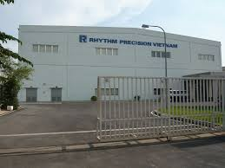
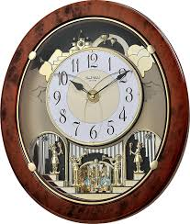
RHYTHM PRECISION VIET NAM
Molding, Injection, SMT, Assembly
3S ERP
01/2019 – 11/2019
Mrs Oanh – Project Management
Mobile – 0904 283 696
www.itgvietnam.com

Slide 16
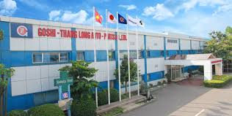
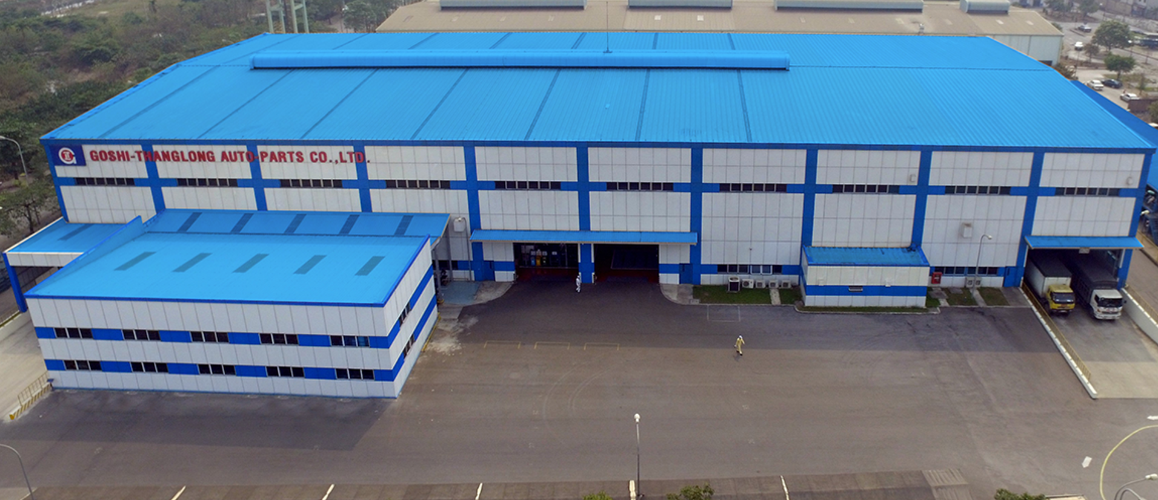
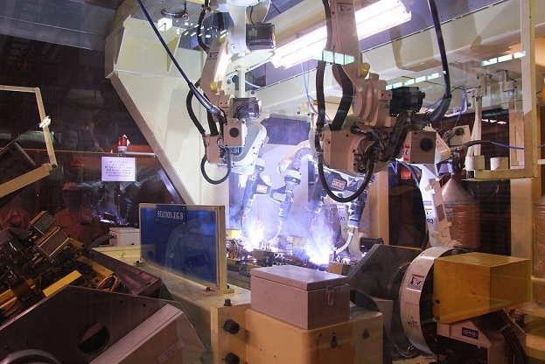
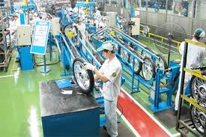
GOSHI – THANG LONG AUTO PARTS
Mechanical Devices for Honda, Yamaha
ERP, MES
04/2019 – 01/2020
Mr Tu Anh – Project Manager
Mobile – 0903 417 383
www.itgvietnam.com

Slide 17
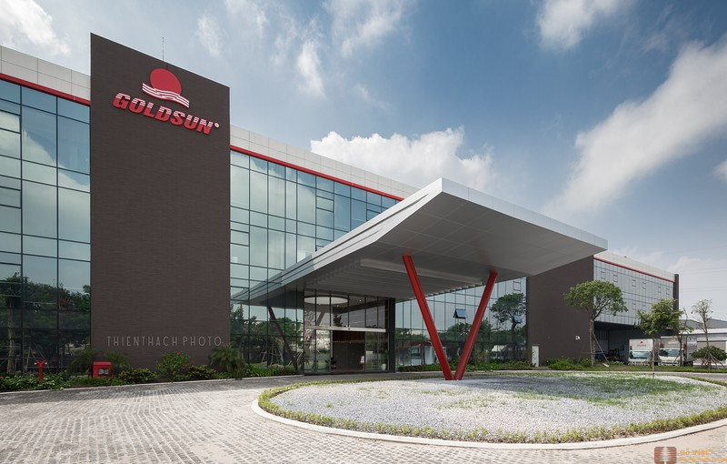
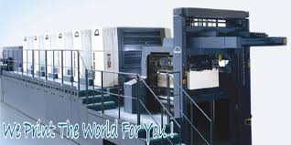
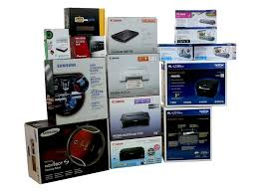
GOLDSUN PRINTING AND PACKAGING
Packaging (Flexo & Ofset)
ERP, MES
06/2016 – 11/2017
Mrs Khanh Ly – Project Director
Mobile – 0904091999

Slide 18
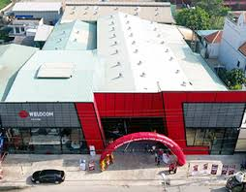
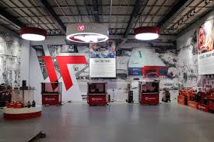
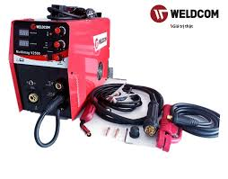
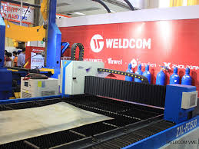
WELDCOM INDUSTRY CORPORATION
Welder, CNC, …
ERP, CRM, eWarranty, HRM
06/2015 – 02/2016
Mrs Thuy – PM
Mobile – 0918385828
www.itgvietnam.com

Slide 19
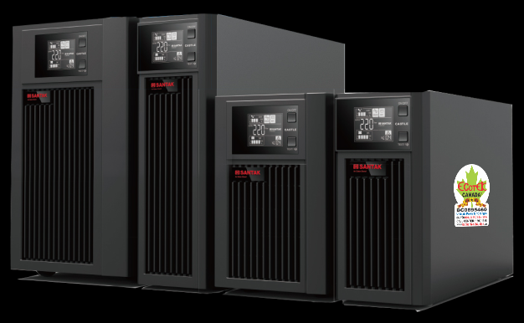
NGUYEN HA CORPORATION
UPS, BATTERY,…
ERP, CRM, eWarranty, HRM
06/2016 – 03/2017
Mr Tuan – PM
Mobile – 0905471362
www.itgvietnam.com

Slide 20
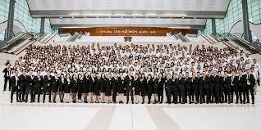
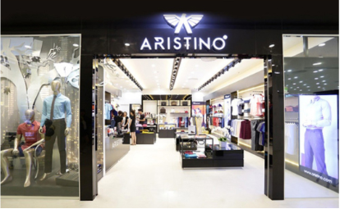
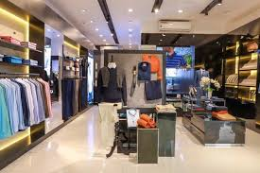
KG VIET NAM
Fashion and Retail
ERP. DMS, CRM
04/2019 – 01/2020
Mr Thang – IT Manager
Mobile - 0916452727
www.itgvietnam.com

Slide 21
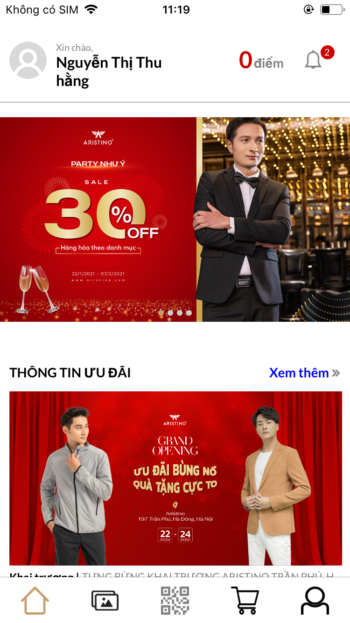
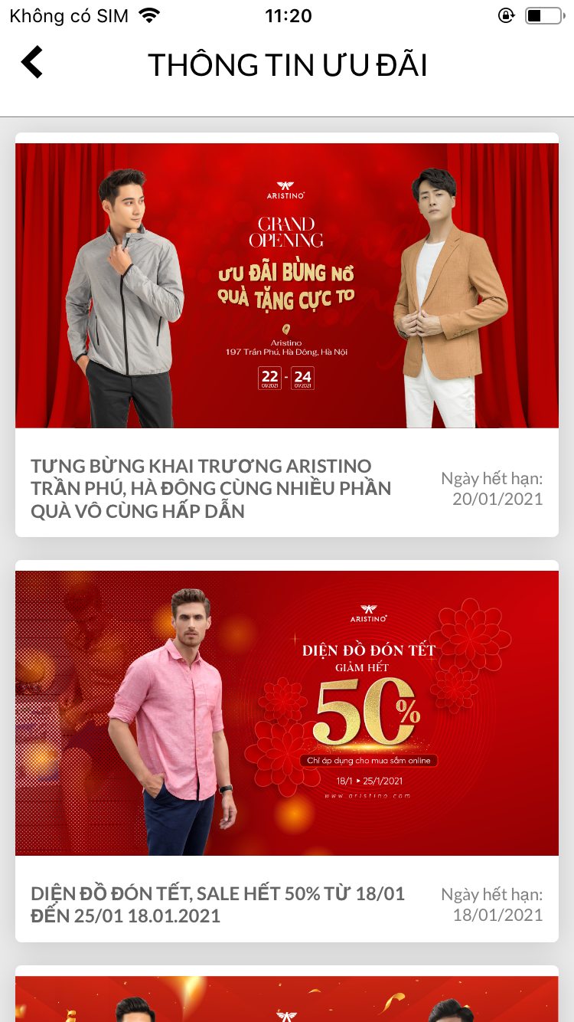
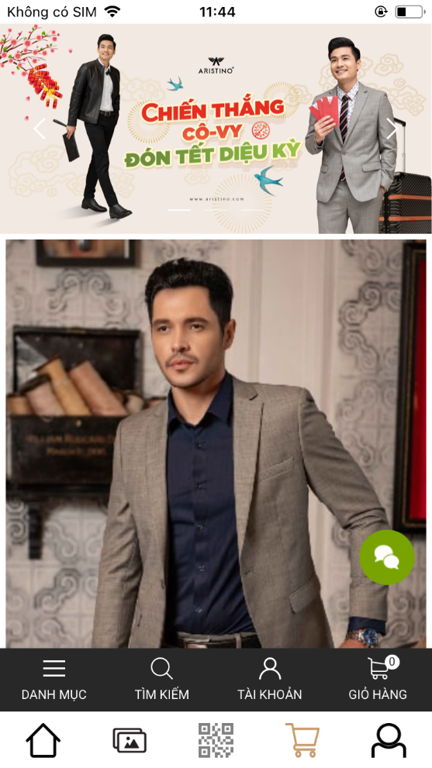
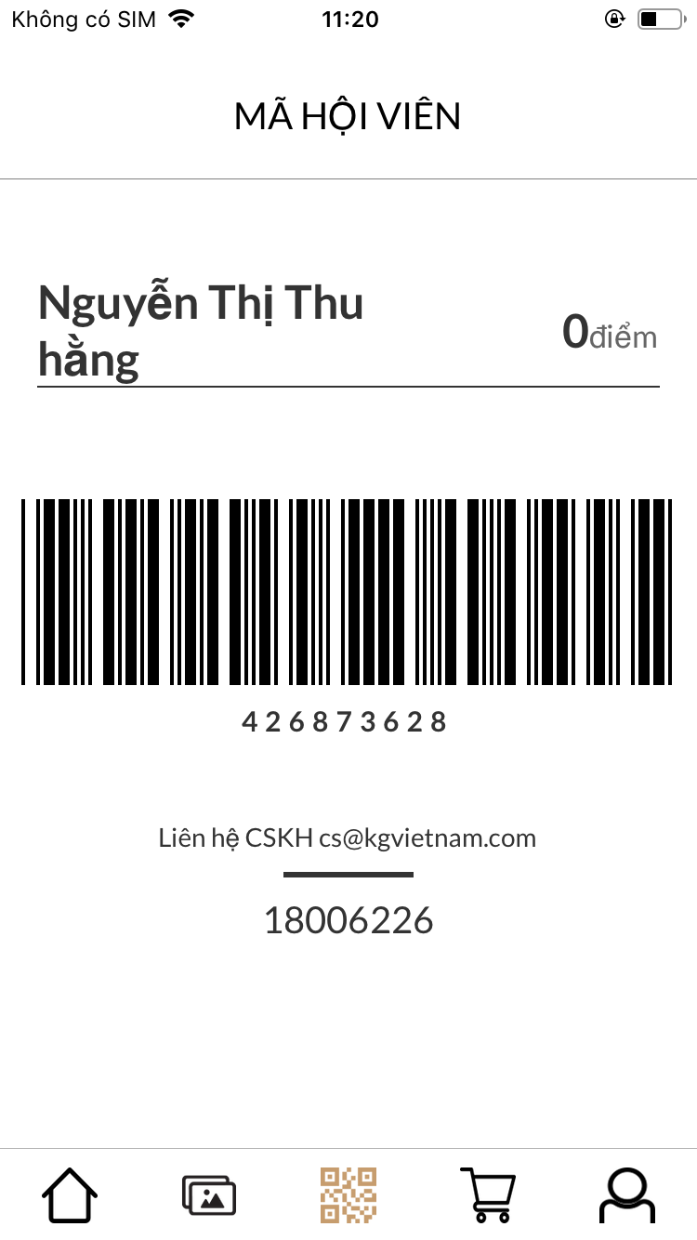
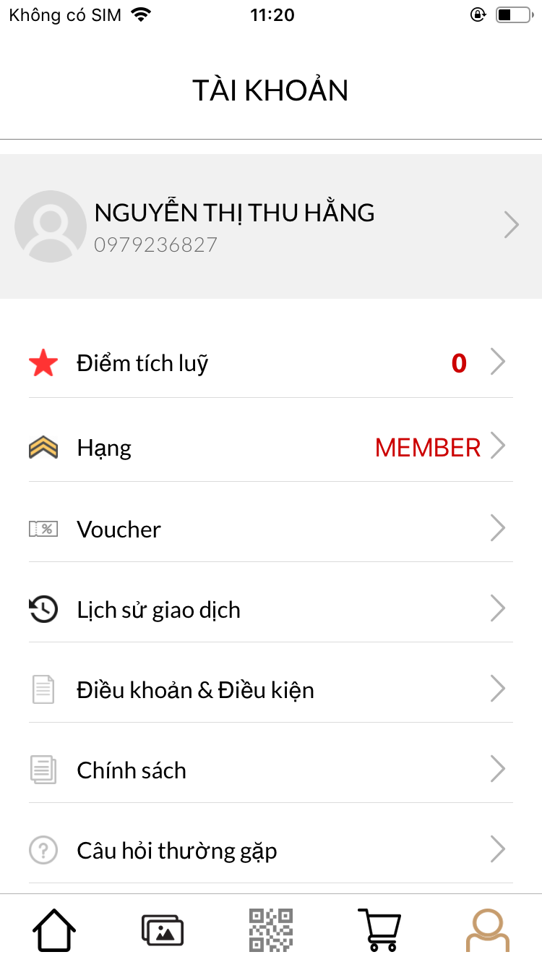
KG VIET NAM – APP CRM (demo)
www.itgvietnam.com

Slide 22
TECHNOLOGY OF 3S SYSTEM

Slide 23
TECHNOLOGY OF 3S SYSTEM
Back-end: Microsoft.NET Framework 4.5, Web API
Front-end: Angularjs 1x, Bootstrap 3x
Database Name: PostgreSQL
Write-ahead Logging (WAL)
Replication: Asynchronous, Synchronous, Logical
Point-in-time-recovery (PITR), active standbys
Security
Reliability, Disaster Recovery
Authentication: GSSAPI, SSPI, LDAP, SCRAM-SHA-256, Certificate, and more
Robust access-control system
Column and row-level security
Multi-factor authentication with certificates and an additional method
Security
Indexing: B-tree, Multicolumn, Expressions, Partial
Advanced Indexing: GiST, SP-Gist, KNN Gist, GIN, BRIN, Covering indexes, Bloom filters
Transactions, Nested Transactions (via savepoints)
Multi-Version concurrency Control (MVCC)
Parallelization of read queries and building B-tree indexes
Table partitioning
Just-in-time (JIT) compilation of expressions
Concurrency, Performance

Slide 24
TECHNOLOGY OF 3S SYSTEM
Database Name: PostgreSQL
Procedural Languages: PL/PGSQL, Perl, Python (and many more)
SQL/JSON path expressions
Foreign data wrappers: connect to other databases or streams with a standard SQL interface
Customizable storage interface for tables
Many extensions that provide additional functionality, including PostGIS
Extensibility
Internationalisation, Text Search
Support for international character sets, e.g. through ICU collations
Case-insensitive and accent-insensitive collations
Full-text search
Suitable for many operating systems
SOLARIS
Many large companies use it | Uber | Netflix | Instagram | Alibaba Travel | Atlassian | ….

Slide 25
TECHNOLOGY OF 3S SYSTEM
ReactNative (Developed by Facebook)
Save Time and Cost to Develop An Application
Less code, Less Bugs
Developing one times, but use both iOS and Android
Optimazation Resources
Biggest User community
Advantage
Big data for Big Companay | Facebook | Skype | Instagram | ….

Slide 26
THANK YOU

