Slide 1
Climate Change Risk Assessment and Management
Definitions of Disaster, Risk, Hazard and Vulnerability
Climate and disaster risk reduction
Identifying vulnerability (physical, social, and economic)
Adaptive capacity
Resilience
Nguyen Ngoc Huy

Slide 2
What have you learned from previous lectures?
Concept and definition of climate change (?)
Definition of vulnerability (?)
Linkage between climate change and natural hazards (?)
What will we learn in this subject (?)

Slide 3
Structure of Climate Change Risk Assessment and Management subject
Chapter 1 Definitions
1.1 Definitions of Disaster, Risk, Hazard and Vulnerability
1.2 Climate and disaster risk reduction
1.3 Identifying vulnerability (physical, social, and economic)
1.4 Sectoral vulnerability
1.5 Adaptive capacity
1.6 Resilience
Chapter 2 Risk Assessment
2.1 Key concepts
2.2 Procedures of disaster risk assessment
2.3 Methods of disaster risk assessment

Slide 4
Structure of Climate Change Risk Assessment and Management subject
Chapter 3. Extreme Events
3.1 What are extreme events?
3.2 Probabilistic
3.3 Extreme ‘physical’ events definitions
Chapter 4. Catastrophic Disasters
4.1 Nonlinear relations between extreme events and extreme losses
4.2 What makes a catastrophic hydro- or geo-meteorological disaster?
Chapter 5. Climate change modifications to extremes and challenges
5.1 Changes to probability functions
5.2 IDF curves and infrastructure design implications under climate change uncertainty
Chapter 6. Extreme event risk reduction and management
6.1 Adaptation options for addressing climate change risks
6.2 Holistic approaches within sustainability framework
6.3 Disaster risk reduction and management
6.4 Examples of good practices

Slide 5
What is hazard?
A hazard is a process, phenomenon or human activity that may cause loss of life, injury or other health impacts, property damage, social and economic disruption or environmental degradation. Hazards may be natural, anthropogenic or socio-natural in origin (UNISDR, 2016).
What is difference between hazard and disaster?
will be happened (?)
It happened ! (?)

Slide 6
What is “Disaster”?
A serious disruption of the functioning of a community or a society causing widespread human, material, economic or environmental losses which exceed the ability of the affected community or society to cope using its own resources. A disaster is a function of the risk process. It results from the combination of hazards, conditions of vulnerability and insufficient capacity or measures to reduce the potential negative consequences of risk. (UNISDR)
Natural hazards: Earthquake, flood, tsunami, typhoon/cyclone, drought, etc.

Slide 7
Disaster: Interactions of three major systems
Earth’s physical systems
Atmosphere, biosphere, hydrosphere, and lithosphere A warming climate and environmental degradation may produce more dramatic meteorological events such as storms, floods, droughts, and extreme temperature.
Human systems
Population, awareness, culture, technology, social class, economics, politics, religion, education, etc.
Constructed systems
Buildings/housing, roads, bridges, river banks, dams, other public infrastructure

Slide 8
Environmental issues and natural disasters: The two sides of a coin (heads and tails)
Environmental issues are bad effects of development to natural environment
Disasters are bad effects of natural phenomena to developed environments
Environmental issues may cause disasters: Examples?
Disasters may cause environmental issues: Examples?

Slide 9
What is “disaster risk”?
The potential loss of life, injury, or destroyed or damaged assets which could occur to a system, society or a community in a specific period of time, determined probabilistically as a function of hazard, exposure, vulnerability and capacity (UNISDR).
Classic definition
Current definition
What is the difference?

Slide 10
Vulnerability vs. Capacity
Vulnerability
The conditions determined by physical, social, economic and environmental factors or processes which increase the susceptibility of an individual, a community, assets or systems to the impacts of hazards.
Capacity
The combination of all the strengths, attributes and resources available within an organization, community or society to manage and reduce disaster risks and strengthen resilience. (UNISDR)
How can we measure the vulnerability and capacity of a community or country?

Slide 11
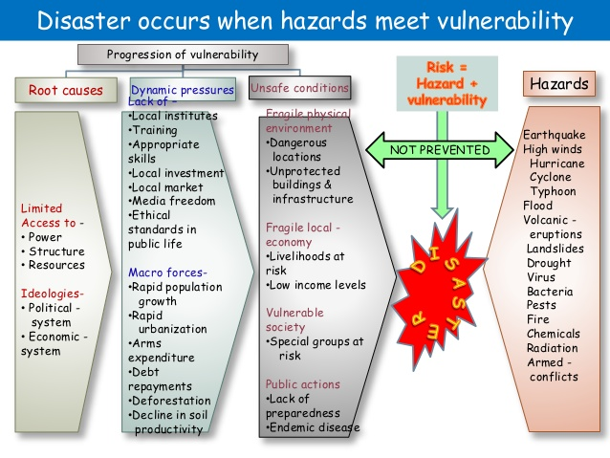
Vulnerability analysis
Disaster Risk =Hazard × Vulnerability (Root causes, dynamic pressure, unsafe conditions)

Slide 12
Vulnerability (physical, social, and economic)
Physical (system)
Infrastructure
System (landscape/ natural resources)
Social (agent)
Human (capacity/ social capital/ culture/ knowledge/ experience)
Ability to learn
Institution (policy/ coordination / sharing / direction )
Risk communication
Economic
Financial resource
Insurance

Slide 13
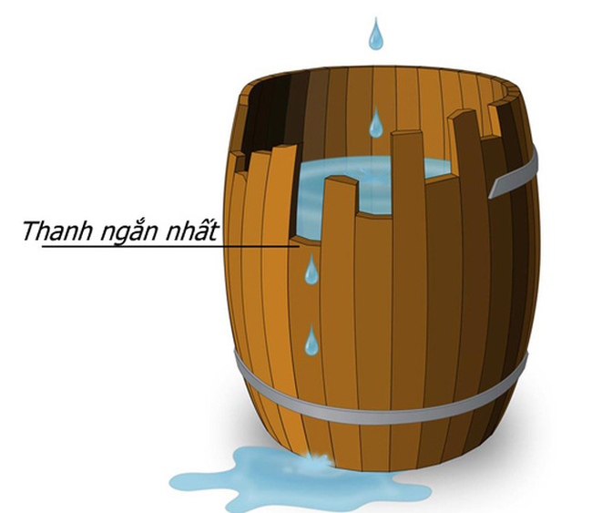
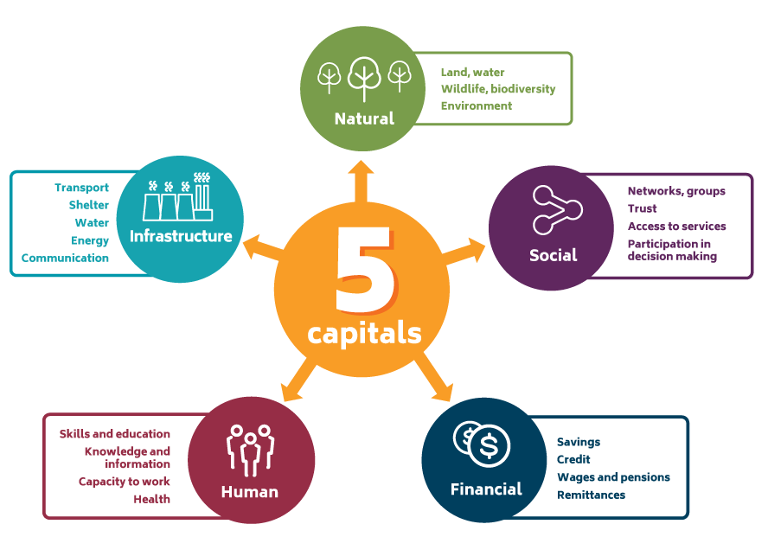
Component of Capacity and capacity assessment
Capacity level

Slide 15
Disaster Risk of Low Probability-High Consequences (once every hundreds or thousands years)
Data and knowledge are little
Social environment is totally different
Though the damage will be destructive, the expected value of loss would be relatively small
Ignorance, indifference or postponement of countermeasures
More vulnerable communities / Total destruction in case of such an event
It is a big challenge how our society tackles this kind of disasters.

Slide 16
Memory of disasters
3 days: bored (people)
3 months: subsided (people)
3 years: forgotten (people)
30 years: extinguished (organization)
60 years: forgotten (communities)
300 years: disappeared (societies) (source: by Professor Hatamura)
It is essential how to transfer the memory or lessons of deadly disasters to the next and following generations

Slide 17
Resilience
The ability of a system, community or society exposed to hazards to resist, absorb, accommodate, adapt to, transform and recover from the effects of a hazard in a timely and efficient manner, including through the preservation and restoration of its essential basic structures and functions through risk management (UNISDR).
Disaster Resilient Communities
Minimal loss of life
Limited interruption of public services
Timely resumption of business operations
Management of the response operation with or without governments assistance
Recovery to pre-disaster condition in a timely, pre-planned mode

Slide 18
Disaster risk management & Disaster risk reduction
A qualitative or quantitative approach to determine the nature and extent of disaster risk by analyzing potential hazards and evaluating existing conditions of exposure and vulnerability that together could harm people, property, services, livelihoods and the environment on which they depend.
Disaster risk management is the application of disaster risk reduction policies and strategies to prevent new disaster risk, reduce existing disaster risk and manage residual risk, contributing to the strengthening of resilience and reduction of disaster losses (UNISDR).
What is the difference between disaster risk assessment and disaster risk management?
What is the difference between disaster prevention and disaster reduction?

Slide 19
Disaster Reduction (not Prevention?)
It is not possible to prevent all the disasters.
It is not politically correct nor economically rational to try to prevent all the disasters.
It is a compromise between the cost of disasters and the cost to reduce the disasters.
Purpose of disaster reduction
To protect people and structures Significantly reduce the risk of death, injury, economic costs, and destruction of natural and cultural resources that result from natural hazards.
To minimize the costs of disaster response and recovery

Slide 21
PDCA (plan–do–check–act) Cycle
Interactive four-step management method for control and continuous improvement of processes and products. It is also known as the Deming cycle.
PLAN: Establish the objectives and processes in accordance with the expected output.
DO: Implement the plan, execute the process, make the product.
CHECK: Study the actual results and compare against the expected results.
ACT: Request corrective actions on significant differences between actual and planned results.

Slide 22
Steps of disaster risk management
1. Understand potential risk Risk assessment is the first step.
2. Judge necessity of countermeasures Mitigation, emergency response, or insurance
3. List up countermeasures
4. Select countermeasures
5. Implement (and monitor) countermeasures
6. Feed back

Slide 24
Business Continuity Management (BCM)
Bankruptcy of local businesses >>> unemployment, no income of local people
Deaths/injuries of local people >>> Loss of employees
Long term corporate survival Even major corporations may be damaged to bankruptcy by a disaster
Resilient and sustainable businesses are the nucleus to ensuring social continuity.
Securing the lives of staff and customers
Contribution to the recovery and reconstruction of the communities

Slide 25
Steps of BCM (applicable to governments)
1. Understand your business Most crucial parts of business activities
2. Identify threats and risks (business impact assessment) what kinds of disasters are anticipated, how long supply will be halted, direct and indirect loss estimation
3. Develop continuity strategies/plan Back up, time line for recovery, who will be responsible for emergency and recovery, collection and dissemination of information.
4. Implement the plan
5. Test and maintain the plan

Slide 26
Insurance as disaster risk management
Huge loss + low probability → insurance is suitable as risk transfer
If your house would be destroyed by a disaster, you could reconstruct a house with the insurance money
Problems of disaster insurance

Slide 27
Disaster mitigation through insurance
Insurance itself is not considered a mitigation measure because it redistributes rather than reduces losses. But insurance industry can facilitate mitigation as follows:
1. Education and information
2. Participation in the model code process
3. Offering financial incentives (discount or penalty)
4. Limiting the availability of insurance

Slide 28
Importance of risk communication
Risk perception of people is generally based on and biased by the risk communication through mass media.
Various risk communication programs in the past have been less effective than planned.
Inability of the experts to understand they have to work together with the public Experts tend to simply “educate” them. One-way risk communication would not work.
While trust is basic building block of any effective warning system, it is too scarce in both directions. Officials do not trust the public, and the public do not trust officials either.

Slide 29
Disaster information: overestimated or underestimated
Mass media
They tend to pick up only the worst case (damage estimate, tsunami height, flood depth, the worst disaster scenario, etc.) out of various scenarios.
As a result, their information is overestimated like a person who is always crying “Wolf!”.
Experts
Due to lack of data and difficulties of prediction or estimate, they tend to overestimate or underestimate risk.
To avoid taking responsibility later, officers tend to warn the maximum.

Slide 30
Steps of risk communication: CAUSE Model
Step 1: Credibility
Build up “trust”
Step 2 : Awareness
Make people recognize the risk
Step 3 : Understanding
Make them understand better the risk
Step 4 : Solutions
Make them solve the problems and plan the actions
Step 5 : Enactment
Make them take actions

