Slide 1
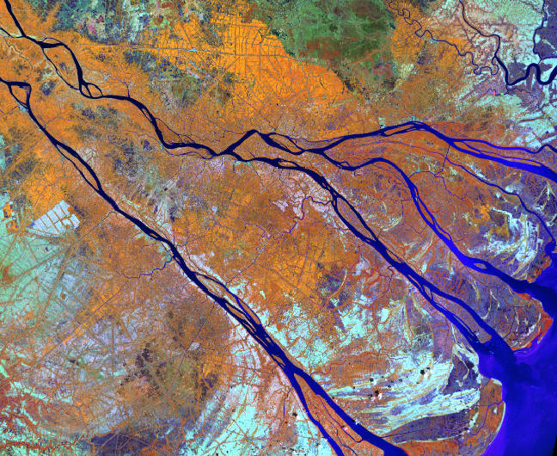

The trend of Geo-Informatic analysis for climate change response

Slide 2
Contents
GeoInformatics evolution
Bigdata in Geo-informatic
Geo-informatic – analysis
http://svs.gsfc.nasa.gov/vis/a000000/a002600/a002682/
http://imgsrc.hubblesite.org/hu/db/2001/10/images/a/formats/640_wallpaper.jpg
Notes:
Remote sensing is the collection of information about the earth’s surface from a distance. Usually this information is collected using sensors on airplanes or satellites.

Slide 3
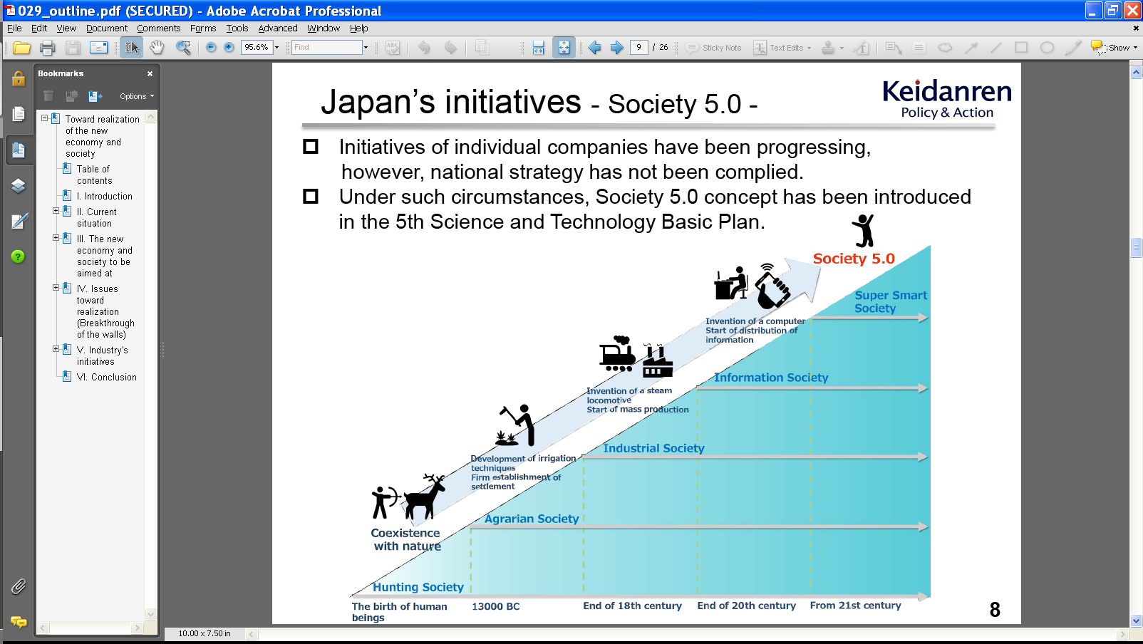
GeoInformatics evolution
http://www.keidanren.or.jp/en/policy/2016/029_outline.pdf
Notes:
Remote sensing is the collection of information about the earth’s surface from a distance. Usually this information is collected using sensors on airplanes or satellites.

Slide 4
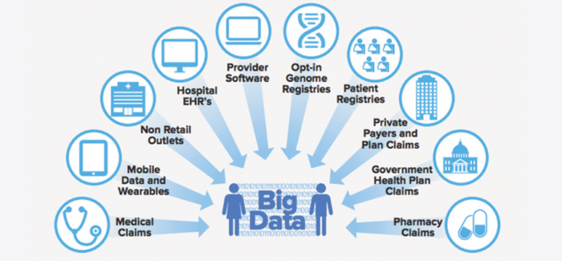
Bigdata in Geo-informatic
http://www.keidanren.or.jp/en/policy/2016/029_outline.pdf
Notes:
Remote sensing is the collection of information about the earth’s surface from a distance. Usually this information is collected using sensors on airplanes or satellites.

Slide 5
Geo-informatic – analysis
Bigdata in Geo-informatic
WE ARE HERE
Traditional
http://www.keidanren.or.jp/en/policy/2016/029_outline.pdf
Notes:
Remote sensing is the collection of information about the earth’s surface from a distance. Usually this information is collected using sensors on airplanes or satellites.

Slide 6

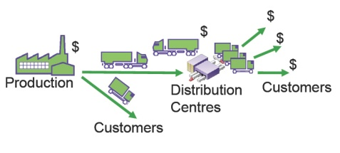
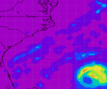



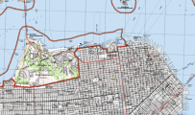

Geo-informatic – analysis
Intelligent Information
Analysis Information
Raw Information
i
I
I
i
I
i
http://www.keidanren.or.jp/en/policy/2016/029_outline.pdf
Notes:
Remote sensing is the collection of information about the earth’s surface from a distance. Usually this information is collected using sensors on airplanes or satellites.

Slide 7
Thank you
http://svs.gsfc.nasa.gov/vis/a000000/a002600/a002682/
http://imgsrc.hubblesite.org/hu/db/2001/10/images/a/formats/640_wallpaper.jpg
Notes:
Remote sensing is the collection of information about the earth’s surface from a distance. Usually this information is collected using sensors on airplanes or satellites.

