Slide 1
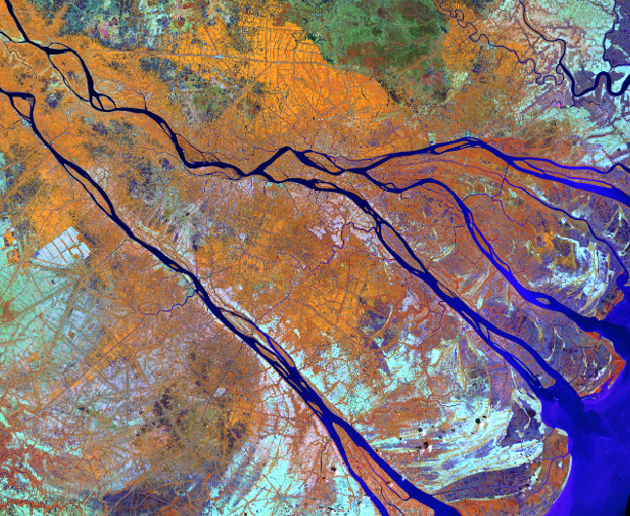
Geo-informatics and Data Analysis for climate change response

Slide 2
Contents
GIS and Remote Sensing
The trend of Informatic analysis
Climate change respond
http://svs.gsfc.nasa.gov/vis/a000000/a002600/a002682/
http://imgsrc.hubblesite.org/hu/db/2001/10/images/a/formats/640_wallpaper.jpg
Notes:
Remote sensing is the collection of information about the earth’s surface from a distance. Usually this information is collected using sensors on airplanes or satellites.

Slide 3
Method
Presetation - Teatcher
Topic - Teatcher and student
Presentation - student
Question
Notes:
Remote sensing is the collection of information about the earth’s surface from a distance. Usually this information is collected using sensors on airplanes or satellites.

Slide 4
Schedule
1. 3/4/2019 Morning
- Theory
2. 5/4/2019 Morning
- Topic and presentation
http://svs.gsfc.nasa.gov/vis/a000000/a002600/a002682/
http://imgsrc.hubblesite.org/hu/db/2001/10/images/a/formats/640_wallpaper.jpg
Notes:
Remote sensing is the collection of information about the earth’s surface from a distance. Usually this information is collected using sensors on airplanes or satellites.

