Slide 1
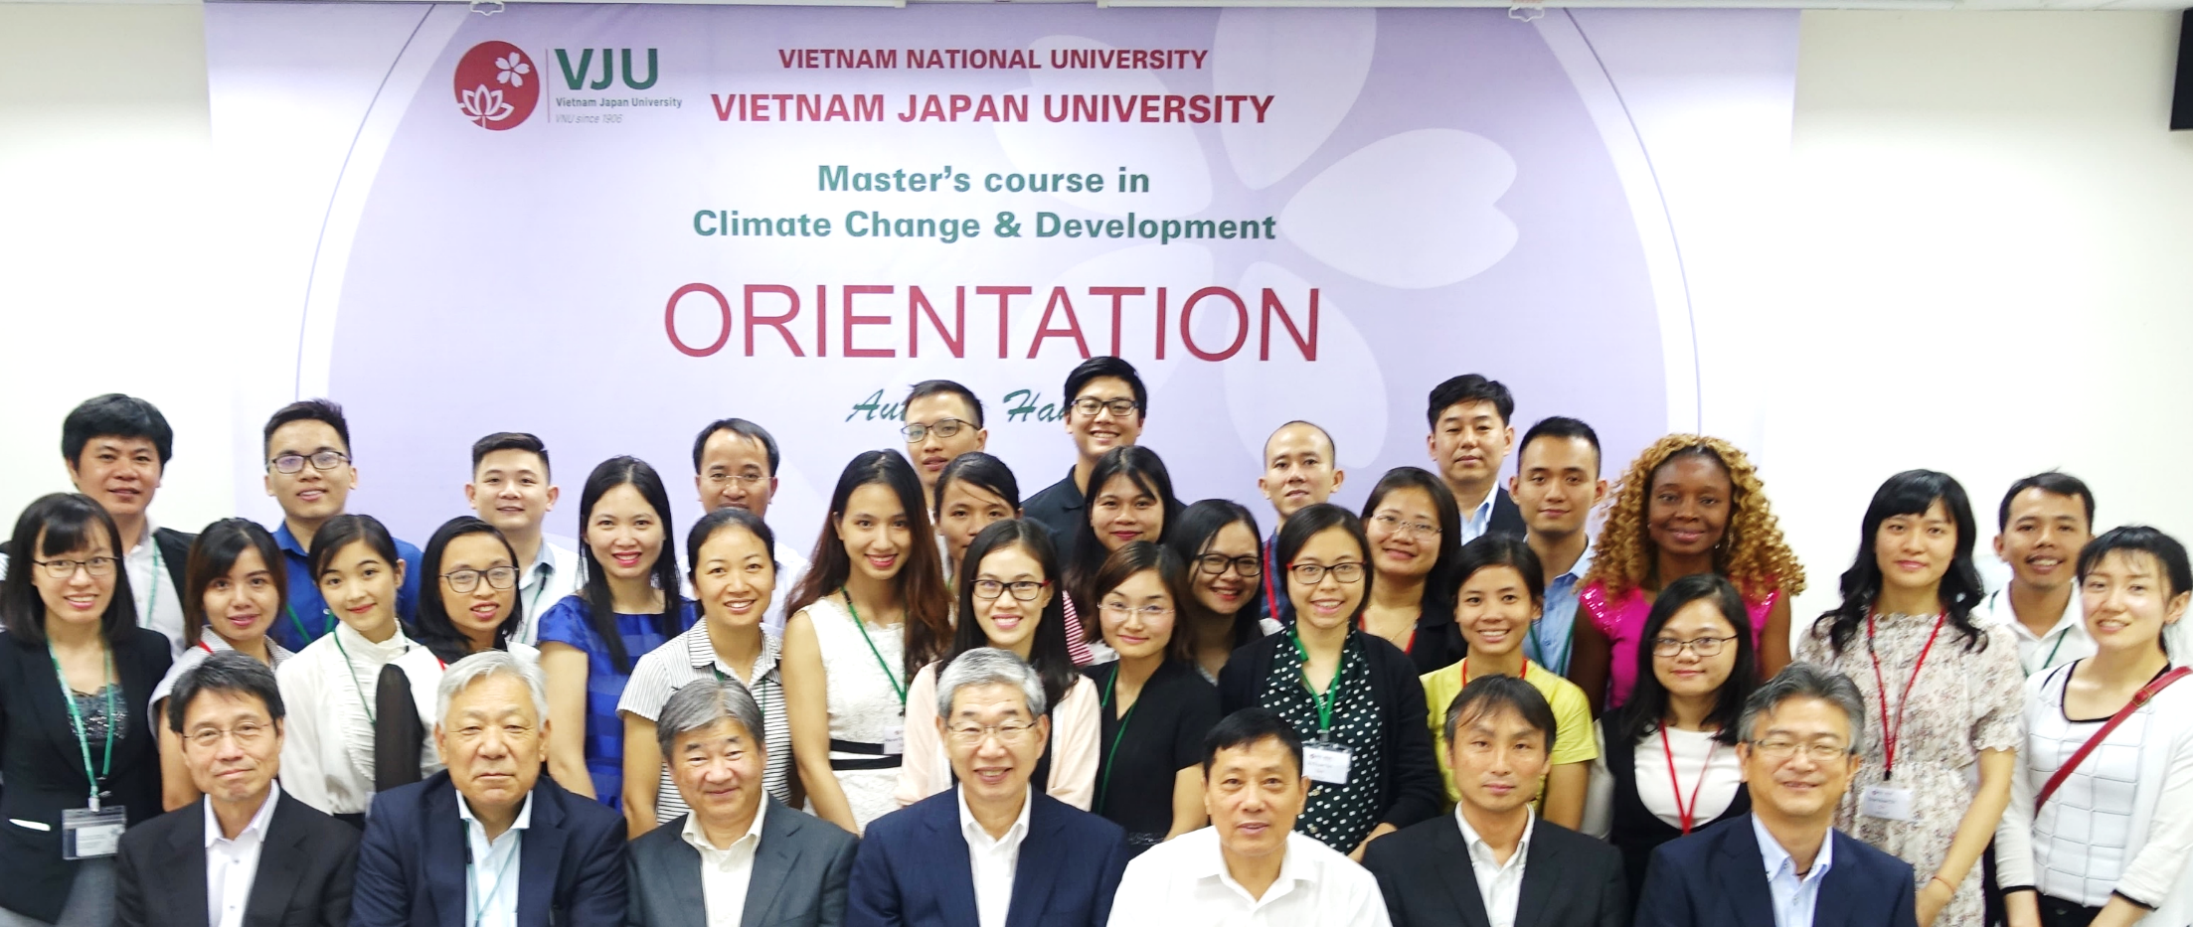
Brief introduction about Master’s Program on Climate Change & Development MCCD

Slide 2
Aiming of establishing the Master’s program in Climate Change & Development (MCCD)
Background:
Growing concern over the Climate Change in Vietnam
Needs for developing countermeasures against the climate change impacts
Needs for creating a new climate change business for sustainable development
Demands for human resource coping with CC issues

Slide 3
Aiming of establishing the Master’s program in Climate Change & Development (MCCD)
Missions of MCCD:
Providing advanced human resources coping with CC. issues
Providing scientific & technological products of high quality
Promoting cooperative relations between Vietnam and Japan
Creating a new Climate Change Business

Slide 4
Potential career opportunities
START up in climate change business
Lecturer, researcher in the domestic and international universities, research institutes
Manager, policy maker, decision supporting staff in municipal governmental agencies
STARTING,
DEVELOPING
CC career
Staff/Consultant in NGO, international organizations, especially in the fields of development, livelihoods and community
Researcher/Manager in national park, nature reserves, tourist areas, biosphere reserves, ….
Staff (technologists, manager, supporting…) in private sectors related to climate change response (adaptation, mitigation)

Slide 5
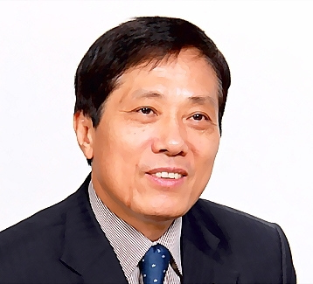
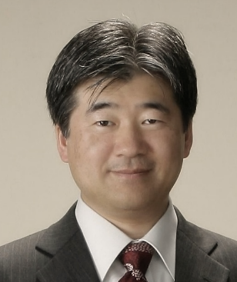
MCCD Program organization
Program Director: Prof. Dr. Mai Trong Nhuan (VNU)
Program Co-Director: Prof. Dr. Kazuyuki KITA (Ibaraki-U)
No. Student: 23 (including 3 international students)
Faculty members
35 Vietnamese (5 Prof.s and 7 Assoc.Prof.s and 19 Dr.s)
VNU-HUS, VNU-UEB, VNU-USSH, VNU-CRES, FTU, NEU, HUNRE …
35 Japanese (22 Prof.s and 6 Assoc.Prof.s and 7 Dr.s)
Ibaraki-U, NIES, U-Tsukuba, U-Tokyo, Fukushima-u…
Coordinating University: Ibaraki University, Japan

Slide 6
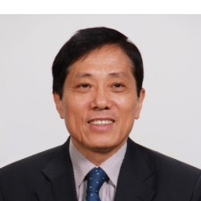
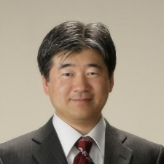
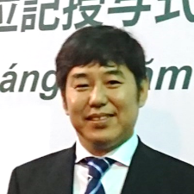
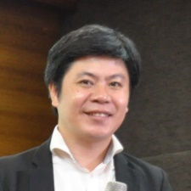
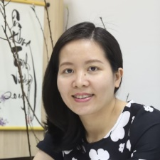
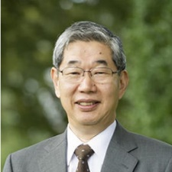
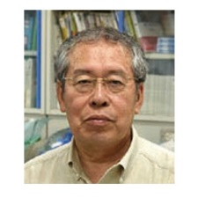
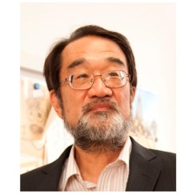
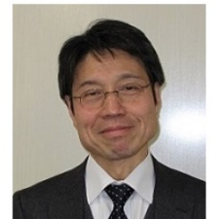
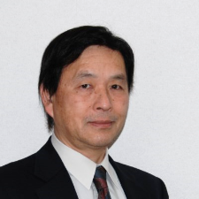
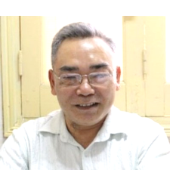
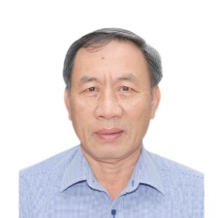
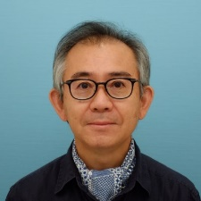
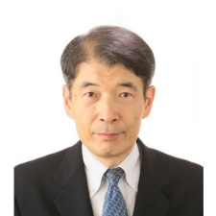
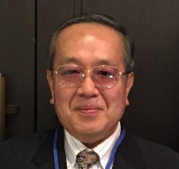
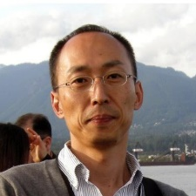
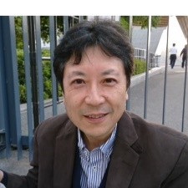
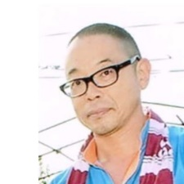
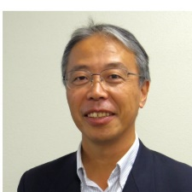
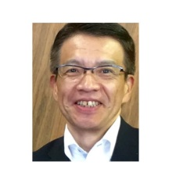
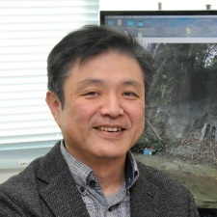
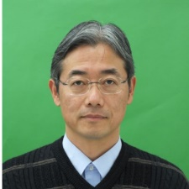
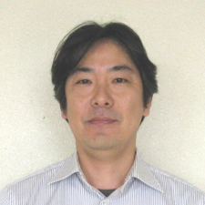
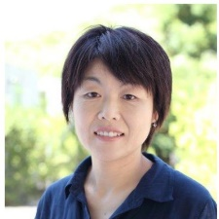
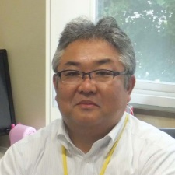
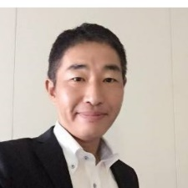
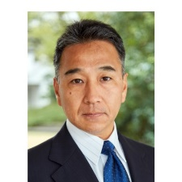
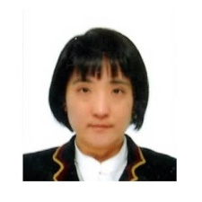
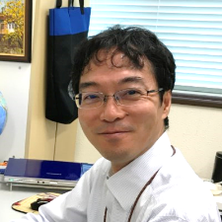
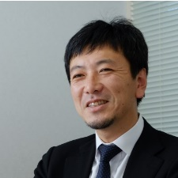
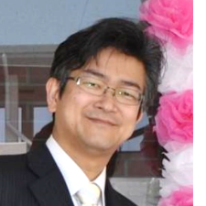
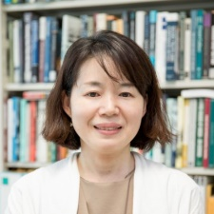
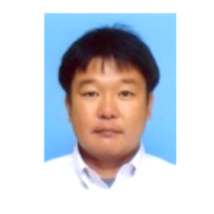
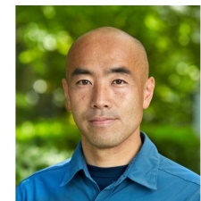
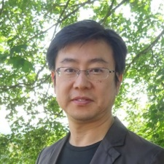
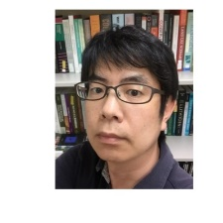
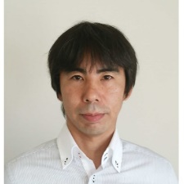
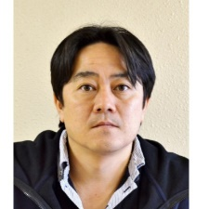
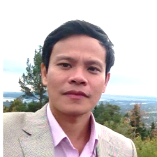
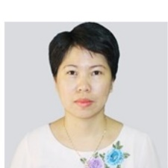
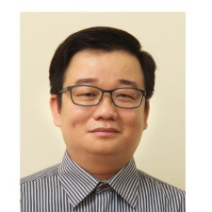
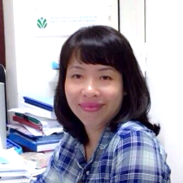
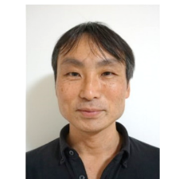
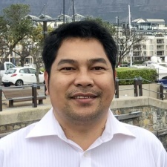
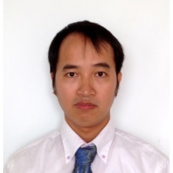
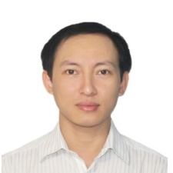
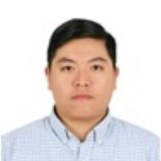
MCCD’s Lecturers 2018-2020

Slide 7
MCCD’s Students 2018-2020
Nickname ニックネーム | Azu アズー | Duyen ズエン | Diu ジウ | Khoa コアー | Tuan トゥアン | Trung チュン | Chi チー
Student ID | 18110041 | 18110042 | 18110043 | 18110045 | 18110046 | 18110047 | 18110048
Full Name | Azu Anthony Anwani | Vu Kim Duyen | Tieu Thi Diu | Tang Anh Khoa | Nguyen Anh Tuan | Nguyen Hoang Trung | Tran Huyen Chi
Birthday | Sep-1992 | Jul-1992 | Dec-1991 | Mar-1991 | Jun-1991 | Oct-1995 | Nov-1995
Hue フエッ | Hanh Mai ハイン マーイ | Tung トゥン | Nghia ギア | Diep ジエップ | Mai マイ | Hang ハン | Tam タム
18110049 | 18110050 | 18110051 | 18110053 | 18110054 | 18110055 | 18110057 | 18110058
Nguyen Thi Dang Hue | Bui Hanh Mai | Do Duy Tung | Thai Trong Nghia | Be Ngoc Diep | Mai Ei Ngwe Zin | Dao Thi Thu Hang | Nguyen Duc Tam
Dec-1991 | Dec-1991 | Nov-1987 | Aug-1986 | Aug-1995 | Jun-1992 | May-1986 | Dec-1989
Kate ケイト | Nhinh ニン | Oanh オァイン | Yen イェン | Thu トゥー | Duong ズオン | Huong フオン | Nickname ニックネーム
18110061 | 18110062 | 18110065 | 18110066 | 18110067 | 18110068 | 18110069 | Student ID
Nkom Bola Nton | Do Thi Nhinh | Pham Thi Oanh | Vu Thuan Yen | Nguyen Hoai Thu | Nguyen Thi Hong Duong | Tran Viet Huong | Full Name
Sep-1984 | Jun-1986 | Nov-1991 | Sep-1990 | Sep-1995 | Jan-1995 | May-1996 | Birthday

Slide 8
Operation of MCCD
MCCD creates good quality assurance conditions for you
Concentration study mode in small-size classroom aiming to ensure quality of teaching/learning/self study activities
Combination of using English (Japanese) and Vietnamese languages in academic activities: transferring professional knowledge and skills as well as cultivating foreign language ability
Focusing on fieldtrip, practical activities, internship and guest lectures

Slide 9
Curriculum Structure
Master dissertation
Internship in Japan and Vietnam
The 2nd year
Research-oriented
Management-oriented
Natural Science
7 subjects
Social Science
8 subjects
Policy & Social
6 subjects
Economics
4 subjects
Common elective
The 1st year
- Sustainable Development in the Context of Climate Change
- Climate Change Risk Assessment and Management
- Social Research on Climate Change
- Economics of Climate Change
- Geo-informatics and Data Analysis for Climate Change Response
Basic subjects on climate change
- Fundamentals of science of climate change I, II
- Climate change impacts and vulnerability assessment
- Climate change mitigation and adaptation

Slide 10
Subjects in MCCD
Elective courses | 19/71
Academic English | 4
Climate Modeling | 3
Social Research on Climate Change | 2
Paleoclimatology | 2
Economics of Climate Change | 3
Integrated Modelling and Complex Systems Science | 2
Climate Policy, Law and Institutions | 2
Environment, Health and Societies | 2
Climate Change Risk Assessment and Management | 3
Communities and Climate Change Adaptation | 2
Climate Projections: Uncertainty and Decision Making | 2
Nature and ecosystem based adaptation | 3
Geo-informatics and Data Analysis for Climate Change Response | 2
Climate Change and Security | 3
Climate Change Innovation | 2
Aqua-Agriculture Adaptation to Climate Change | 3
Energy technologies and management for climate change mitigation | 3
Sustainable Water Management | 3
Climate Change Adaption in Cities | 2
Land Use Planning for Climate Change Response | 2
Development and Sustainable Development in the Context of Climate Change | 2
The Sociology of Climate Change | 3
Cost-Benefit Analysis for Climate Change | 3
Resource and Environmental Economics | 3
Climate Finance | 2
Regional and Urban Development Policy | 2
Agriculture and Rural Development Policy | 2
Environmental Management Systems | 2
Interdisciplinary Fieldwork on Climate Change | 2
Compulsory: 18credits
Elective: 19/71 credits
Internship: 6 credits
Master’s thesis: 12 credits
COURSES | CREDITS
General knowledge | 9
Philosophy | 3
Japanese Language | 6
Fundamental and specific knowledge
Compulsory courses | 18
Fundamentals of Sustainability Science | 3
Methodology and Informatics for Sustainable Science | 3
Fundamentals of Climate Change I | 3
Fundamentals of Climate Change II | 3
Climate Change Impacts and Vulnerability Assessment | 3
Climate Change Mitigation and Adaptation | 3
Internship | 6
Master’s thesis | 12

Slide 11
Class room

Slide 12
Class room

Slide 13
FIELD TRIPS
Field trip

Slide 14
International Workshop

Slide 15
MCCD Admission 2019
The number to be admitted: Max 20
Admission requirements
English proficiency:
Level 3/6 (IELTS 4.0 – 4.5) or equivalent
GPA: See the brochure for the detail
Major background:
Majors in natural sciences; social sciences and behavioral sciences; business and management; other social majors with high-interdisciplinary nature.
Examination
Review of Application documents
Interview test (20-30 minutes)

Slide 16
MCCD Admission 2019
1st entrance examination: Sat 23rd March 2019
Submission dead line: 18th March
2nd entrance examination: The end of July 2019
Submission dead line: 19th July
Hotline: 0966 954 736
Website: www.vju.ac.vn Facebook: www.facebook.com/VietnamJapanUniversity
Email: admission@vju.ac.vn

Slide 17
Further information VJU channel on Facebook

Slide 18
Thank you so much!

